Slide 1
Activity Diagram
&
State Chart Diagram

Slide 2
Static & Dynamic Aspects of distributed applications
UML has two broad categories of models
  Static models - represent the static structural aspects of the application / system
    class diagrams, object diagrams, deployment diagrams, component diagrams
  Dynamic models - represent the dynamic behavioural aspects of the application / system
    use case diagrams, interaction diagrams, state transition diagrams, activity diagrams, operation descriptions

Slide 3
Dynamic System Behaviour
Dynamic system behaviour may be viewed from two perspectives:
  Inter-object behaviour = communication between objects (of classes) = messages
  Intra-object behaviour = encapsulated behaviour of objects = operations & object state

Slide 4
Activity Diagram

Slide 5
Activity Diagram
An activity diagram is a special form of state diagram used to model a sequence of actions and conditions taken within a process. The modeled process may be at the organizational level or at the system level. One of the most valuable uses of the activity diagram is during operation design
Activity diagrams, like interaction are used to model the dynamic behavior of a system and to construct executable systems, whereas interaction diagrams look at how messages pass between objects, activity diagrams focus on the flow between activities (eg. procedures, functions). In this respect, activity diagrams are somewhat related to traditional DFD’s and flowcharts
The OMG Unified Modeling Language Specification defines an activity diagram as:
  "…a variation of a state machine in which the states represent the performance of actions or subactivities and the transitions are triggered by the completion of the actions or subactivities. It represents a state machine of a procedure itself." [OMG99]

Slide 6
Activity diagrams are a useful behavioral modeling tool for the following reasons:
  They describe the internal behavior of an operation pictorially
  They depict activities that can occur in parallel
  They help to identify activities whose responsibility belongs elsewhere
  They allow the discovery of common functionality within a system

Slide 7
Basic Notations
Start State
Activity/Action
Process Order
Transition
Final/End State

Slide 8
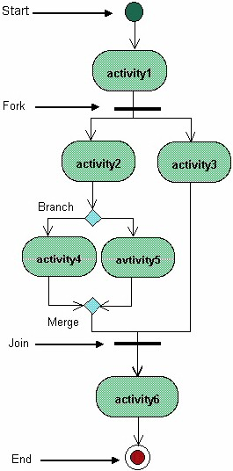

Slide 9
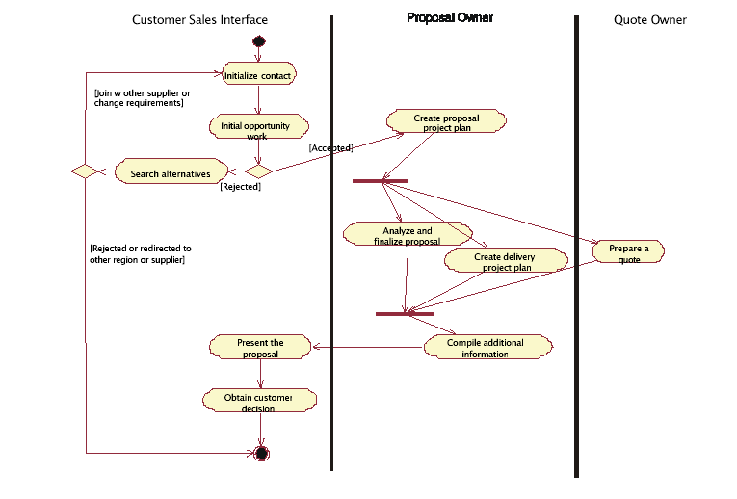
Swim Lanes

Slide 10
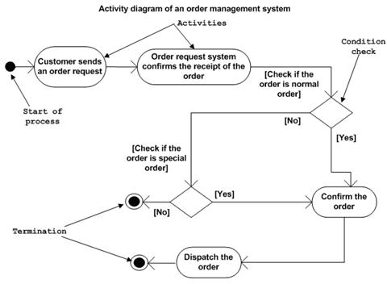
Order Management System

Slide 11
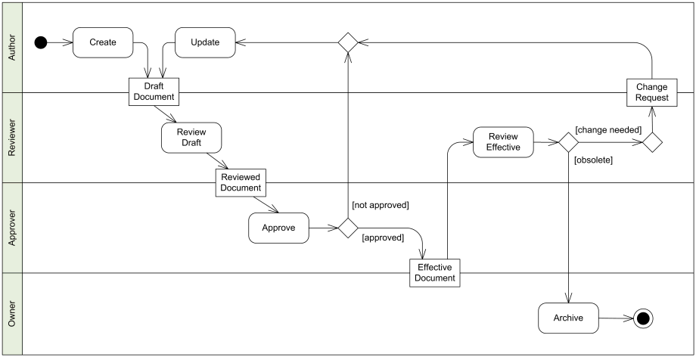
Document Management

Slide 12
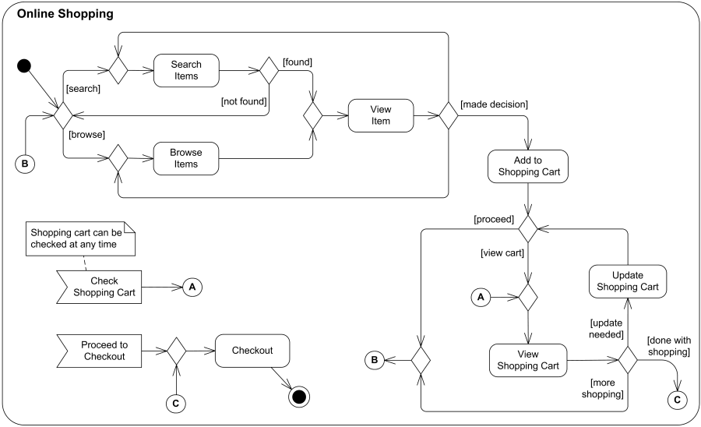
Online Shopping

Slide 13
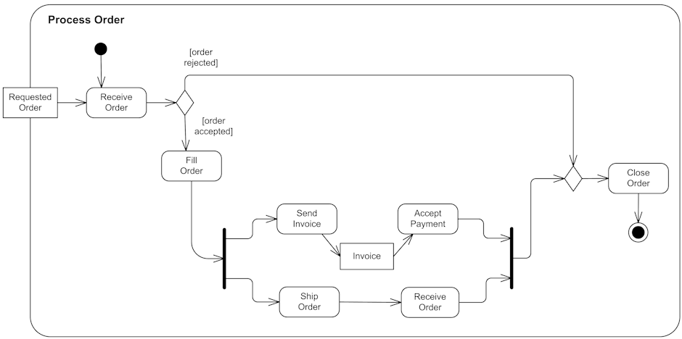
Process Order

Slide 14
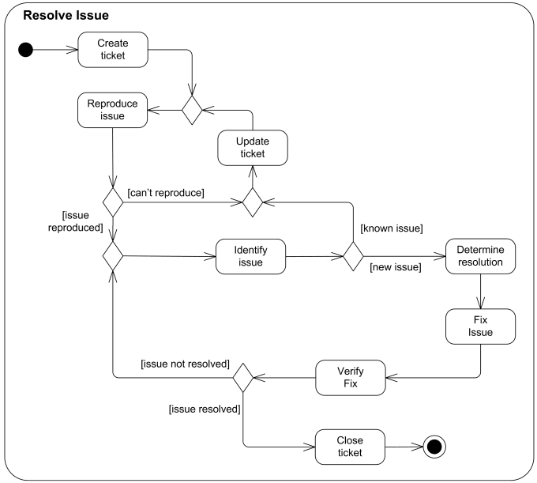
Resolve issue

Slide 16
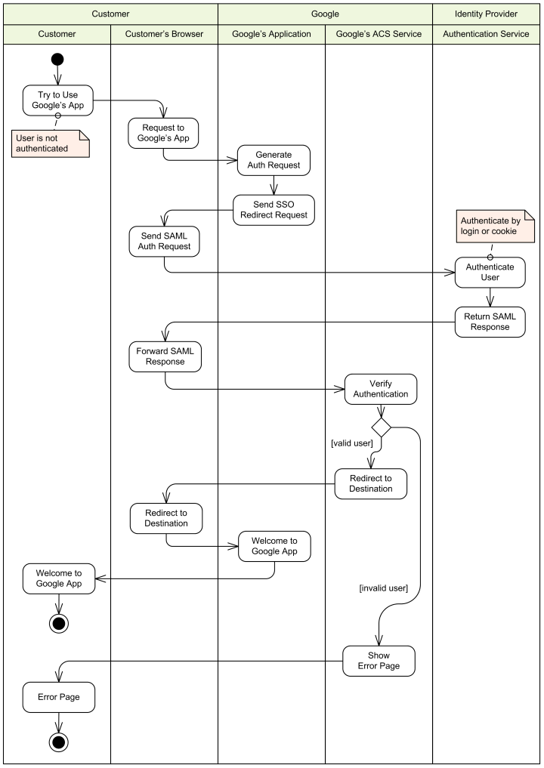
Single Sign-On to Google Apps

Slide 17
State Transition Diagram

Slide 18
State Transition Diagram
Objects have behaviors and state. The state of an object depends on its current activity or condition. A State Chart diagram shows the possible states of the object and the transitions that cause a change in state
  A state transition diagram is used to show the life history of a given object of a class, the events that cause a transition from the state, and the actions that result from a state change
Purpose
  Understand an object’s state
  Develop state diagrams to model this behavior
Things to consider :
  How to determine an object’s possible states?
  Which objects have significant state?
  How do state diagrams map to the rest of the model?

Slide 19
Process For Deriving State Diagrams
Identify and define the states for an object
Identify the events that trigger state transitions
Identify the from and to states involved in each state transition
Add the activities and actions associated with the state transition
Notes:
The recommended process for defining the state behavior of a particular class is as follows:
Identify and define the states
Identify the events
Identify the transitions: For each state, determine what events cause transitions to what states, including guard conditions, when needed
Add activities and actions, where appropriate.
Each of these steps will be described in subsequent slides.

Slide 20
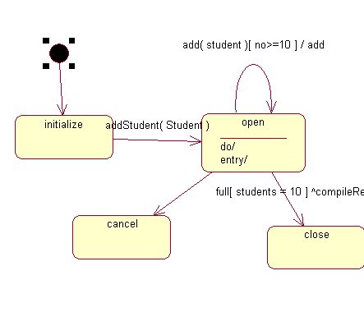

Slide 21
What is a State Diagram?
A directed graph of states (nodes) connected by transitions(directed arcs)
Describes the life history of objects of a given class
State
Event
State Name
stateVar : type = value
entry/ entry activity
do/ activity
exit/ exit activity
event(args)
[guard condition]
^target.sendEvent(args)
/ operation(args)
Other State Name
Transition
Notes:
A statechart is a tool for describing:
States the object can assume
Events that cause an object to transition from state to state
Significant activities and actions that occur as a result
A statechart is a diagram used to show the life history of a given class, the events that cause a transition from one state to another, and the actions that result from a state change. The state space of a given class is the enumeration of all the possible states of an object.
An event is an occurrence that happens at some point in time.
The state of the object determines the response to different events.
A transition is a change from an originating state to a successor state as a result of some stimulus. The successor state could possibly be the originating state. A transition may take place in response to an event, and can be labeled with an event.
A guard condition is a Boolean expression of attribute values which allows a transition only if the condition is true.
The use of statecharts varies widely: Some projects use them very extensively, while other projects may only have one or two, maybe even none.
State charts should be adding value to the analysis and design. They should be used when they are helping to better understand and communicate the analysis and design of the project.
Describe the icon representations in the diagram.
Statecharts are associated with a class because all class instances behave the same way given the same state and the same inputs.

Slide 22
Definitions
1. State
  A state is one of the possible conditions in which an object may exist. It may be signified by attribute values and/or the presence / absence of links.
  A situation during the life of an object which satisfies some condition, performs some activity, or waits for some event.
    the state of an object represents the cumulative history of its behavior.
    State encompasses all of the object's static properties and the current values of each property. All instances of the same class live in the same state space.

Slide 23
Special States
  Initial state
    The state entered when an object is created
    Mandatory
    Can only have one initial state
  Final state
    Indicates the object’s end of life
    Optional
    May have more than one
Initial state
Final state
Notes:
The initial state is the state entered when an object is created
An initial state is mandatory
Only one initial state is permitted
The initial state is represented as a solid circle
A final state indicates the end of life for an object
A final state is optional
More than one final state may exist
A final state is indicated by a bull’s eye
There is exactly one start state and 0..* end states.
To emphasize why a start state is mandatory, ask the students to think about how they would read a diagram with no start state.

Slide 24
Standard Events for a State
  Standard events may be associated with each state.
    Entry - specifies actions on entry to a state
    Do - specifies activities to be performed while in a state
    Exit - specifies actions on exit from a state
State
State Name
stateVar : type = value
entry/ entry action
do/ activity
exit/ exit action

Slide 25
As the object enters the Light state, the On Entry action turns on the light. Next, the Do action changes the behavior of the state so that it blinks five times. Once the object exits the light state (On Exit), the light is turned off.
End
State
Start State
LIGHT
entry/ turn on
do/ blink five times
exit/ turn off

Slide 26
2. State transition
  A change from one state of an object to another caused by an event.
  For each state, determine what events cause transitions to what states, including guard conditions, when needed
  Transitions describe what happens in response to the receipt of an event
3. Event
  An event is an occurrence that may cause the state of a system to change; it has no duration and can precede or follow another event. An event can convey either information or data values from one object to another.
    example:
      class is Course
      event: enroll(studentId)
State A
event[ condition ] / action
State B
State C
do: activity
event(args)
[guard condition]
^target.sendEvent(args)
/ operation(args)

Slide 27
event(args)
[guard condition]
^target.sendEvent(args)
/ operation(args)
4. Guard condition
  The guard-condition is a Boolean expression written in terms of parameters of the triggering event and attributes and links of the object that owns the state machine.
  The guard condition may also involve tests of concurrent states of the current state machine
  Example: birthdate < current_date
    it evaluates to TRUE/ FALSE
5. Action
  an executable atomic computation that results in a change in the state of the model or the return of a value. The action-expression is executed if and when the transition fires.

Slide 28
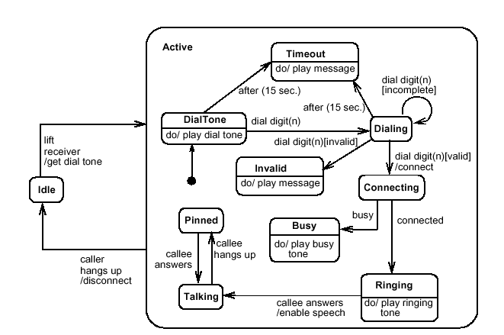
The caller picks up the phone. A dial tones is heard on the phone line. The caller dials 7 digits. A dialling sound is heard on the phone line. After the seventh digit, the phone rings. The callee answers the phone.
Phone Call example:

Slide 29
How Do State Diagrams Map to the Rest of the Model?
Events map to operations
  operation is the request for service
Methods should be updated with state-specific information
States are often represented using attributes
  This serves as input into the Define Attributes step
Open
[numStudents = 10]
Closed
CourseOffering
addStudent
/- numStudents
+ addStudent()

Slide 30
References
Text Book: Applying UML and Patterns by Craig Larman
  Chapter 29: 29.1, 29.2, 29.4, 29.5, 29.8
Material uploaded on Teachers Notes
Other References
  http://www.cbd-hq.com/articles/2000/000101jb_activitydiagrams.asp
  http://www-106.ibm.com/developerworks/rational/library/content/RationalEdge/sep03/f_umlbasics_db.pdf
  http://unicoi.kennesaw.edu/~jbamford/csis4650/uml/UML_tutorial/physical.htm

